Slide 1
This presentations shows to UI layouts in each situation. The screen is always 800 x 600

Slide 2
Main menu
Score Multiplier
Horde Mode
Current Mission List
Mission 1
Mission 2
Mission 3
Settings
Mute
Leaderboards

Slide 3
Main menu – settings popup
Score Multiplier
Various settings and things shown here
Settings
Mute
Leaderboards

Slide 4
Main menu – Leaderboard popup
Score Multiplier
Shows global leaderboard here
Level 1
Level 2
Level 3
Settings
Mute
Leaderboards

Slide 5
Main menu – horde mode
Score Multiplier
Level 1
Level 2
Level 3
Current Mission List
Mission 1
Mission 2
Mission 3
Level 4
Level 5 Locked until …
Level 6 Locked until …
Settings
Mute
Leaderboards

Slide 6
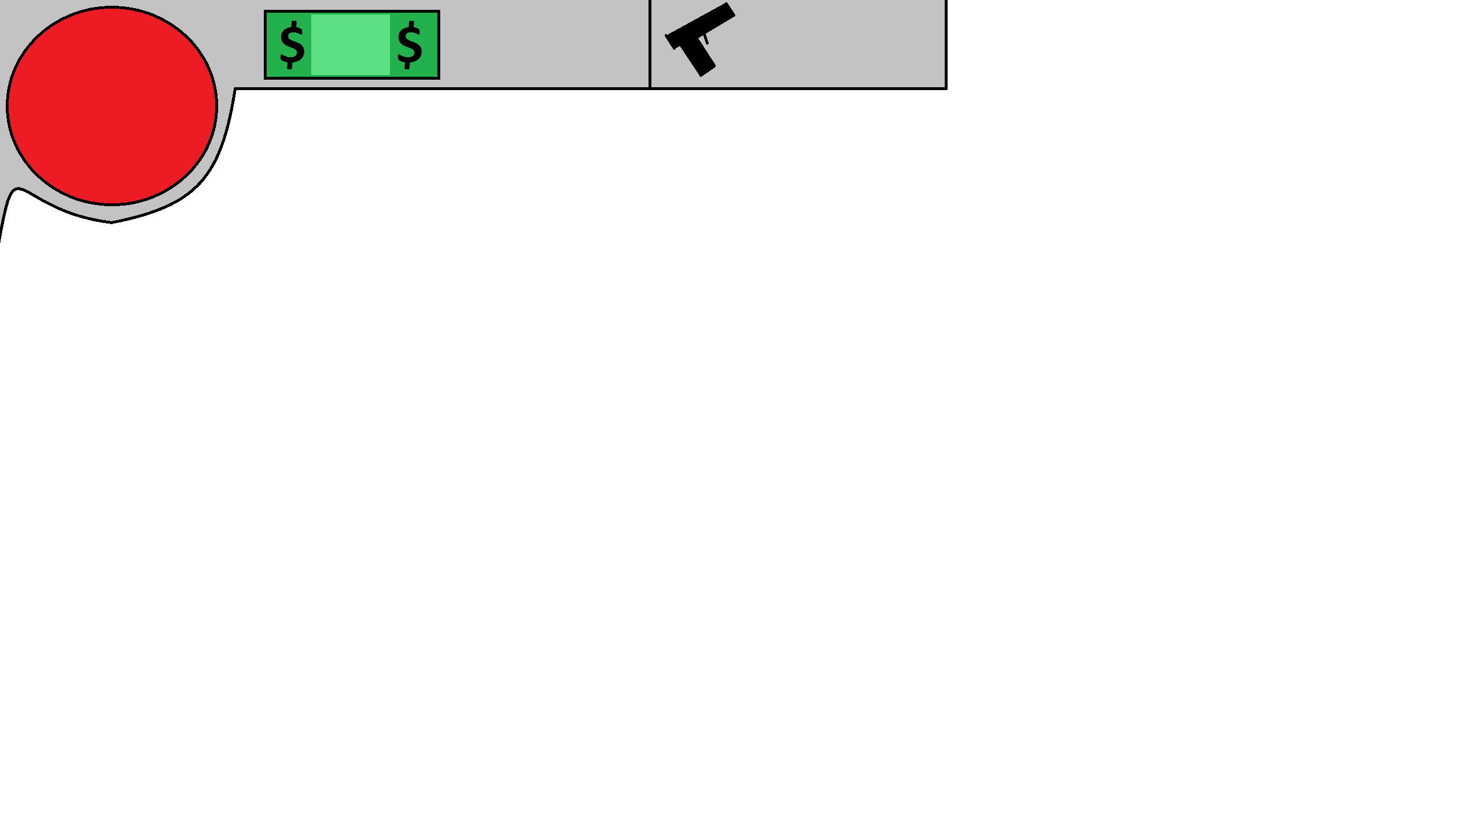
money
Ammo
Menu
Health
Perk Levels
Settings
Mute
Slot 1
Slot 2
Bag,

Slide 7
money
Ammo
Menu
Health
Perk Levels
Invenotry
Settings
Mute
Slot 1
Slot 2

Slide 8
Player here, minecraft style, with health, money, round etc
Also both weapon slots which also show total ammo for each
Various settings and things shown here

